Slide 1
No compromises: distributed transactions with consistency, availability, and performance
Microsoft Research

Slide 2
Distributed transactions
Powerful primitive
Abstract away concurrency and failures
Simplify building distributed systems
Not widely used
Believe to have poor performance
Usually not supported or weakly consistent
Distributed transaction with strong consistency, good performance and high availability

Slide 3
Hardware trends
Lots of DRAM
256GB DRAM per machine and increasing
Non-volatile memory
Li-ion battery integrated with power supply
Flush DRAM to SSD when power failure
Fast networks with RDMA
100 Gbps of bandwidth, 100 M ops/s, 1~3 μs latency RDMA reads and writes
Eliminates storage and networks bottlenecks but leaves the CPU bottlenecks
Notes:
当发生电源故障时，UPS利用电池的能量将内存内容保存到ssd

Slide 4
Design transaction and recovery protocols from first principles to use the hardware effectively
Use one-sided RDMA operation
Reduce message counts
Effectively use parallelism
Notes:
ok，为了充分利用这些硬件，需要设计一个新的协议，这个协议就是为我刚刚那些硬件量身定做的。因此，这篇论文的主要工作是"design transaction and recovery protocols"，那之前说了，在这种硬件条件下，CPU会成为瓶颈，因此在设计这个协议的同时，论文需要遵循以下三个principle：
使用单边的RDMA操作，因为它不仅提供了高吞吐量，低延迟，还做到了CPU efficient
第二个准则是在我们的协议中减少消息数量，因为处理消息需要占用CPU
那当然我们可以肯定也要好好的利用CPU，所以它使用了高效的并行，一个例子是，论文设计的协议在系统恢复时允许新事务的执行，从而提高可用性

Slide 5
Outline
Background
Transaction Protocol
Failure Recovery
Evaluation

Slide 6
Background

Slide 7
FaRM (NSDI’14)
O₈
General platform
Key-value stores, graph stores,
OLTP databases
Symmetric model
Machines execute client
and server code
Shared memory
Transactions
Read, write, alloc, free
O₂
O₃
O₄
O₅
O₁
O₇
O₉
machine
machine
machine
machine
machine

Slide 8
RDMA in FaRM
Read objects with RDMA
NIC performs DMA (CPU not involved)
Reads are consistent (NSDI 14)
Write messages to buffers
Receiver’s CPU polls
Hardware acks the write
Also used as persistent logs
Memory
CPU
2 GB
2 GB
NIC
2 GB
2 GB
Machine B
Notes:
即使事务更新了数据，它同样可以保证了数据一致性，这是在14年他们发表的论文讲述的。

Slide 9
RDMA in FaRM
Read objects with RDMA
NIC performs DMA (CPU not involved)
Reads are consistent (NSDI 14)
Write messages to buffers
Receiver’s CPU polls
Hardware acks the write
Also used as persistent logs
Memory
CPU
2 GB
2 GB
NIC
2 GB
2 GB
ACK
Machine B

Slide 10
Transactions

Slide 11
High performance
One-sided operations
Read objects and log updates
Reduce message counts
Primary-backup replication
Optimistic concurrency control
Access objects only on primaries

Slide 12
Transaction execution
Write set
C
P₁
B₁
P₂
B₂

Slide 13
Two phase commit
Write set
Prepare
Commit
C
P₁
B₁
P₂
B₂

Slide 14
FaRM commit
Lock
Validate
Replicate
Update and unlock
Write set
C
P₁
B₁
P₂
B₂
Notes:
lock确保了写入对象的安全，validate确保了只读取对象的安全。

Slide 15
Failure Recovery

Slide 16
One-sided operations
Complicate recovery
CPU does not process remote access
Cannot rely on e.g. CPU rejecting messages
Configuration change
Precise membership
Recovery
Drain logs before recovery

Slide 17
High availability
Data available instantly
A backup promoted to primary
Short failure detection time(10 ms)
Dedicated network queues, dedicated prioritized thread, memory pre-allocation
Use parallelism
New transactions in parallel with recovery
Recover transactions in parallel
Recover data in parallel
Notes:
使用Dedicated network queues避免网络间的竞争，使用dedicated prioritized thread来避免CPU的竞争，使用memory pre-allocation避免内存分配的干扰。

Slide 18
Failure recovery steps
Detect failure
Change configuration
Recover transaction
Recover data
Notes:
High level

Slide 19
Detecting failures
CM
machine
machine
machine
machine
machine
machine

Slide 20
Detecting failures
CM
machine
ZooKeeper
machine
machine
machine
machine

Slide 21
Reconfiguration
ZK
Config-New
Config-Ack
Config-Commit
CM
Remap
regions
S₁
STOP
Recovery
S₂
S₃
Backup becomes primary

Slide 22
Reconfiguration
ZK
Config-New
Config-Ack
Config-Commit
CM
Remap
regions
S₁
STOP
Recovery
Draining
S₂
S₃
To deal with non-processed log entries
Notes:
NIC网卡无法拒绝过期配置的信息

Slide 23
Transaction recovery
Find recovering
Lock
Replicate log
Vote
Decide
P
B₁
GO
B₂
C
Operations on the region in parallel with recovery

Slide 24
Data recovery
Parallelize data replication
Replicas are balanced
Done in background
Starts after locks acquired at all primaries
Paced

Slide 25
Evaluation

Slide 26
Settings
90 machines
2x InfiniBand Mellanox ConnectX-3 56 Gbps
32 hardware threads
256GB DRAM
Standard OLTP benchmarks
TATP, TPCC
Performance, speed of recovery
3-way replication
Notes:
TATP是用来测试高性能内存数据库的，它主要都是读操作。

Slide 27
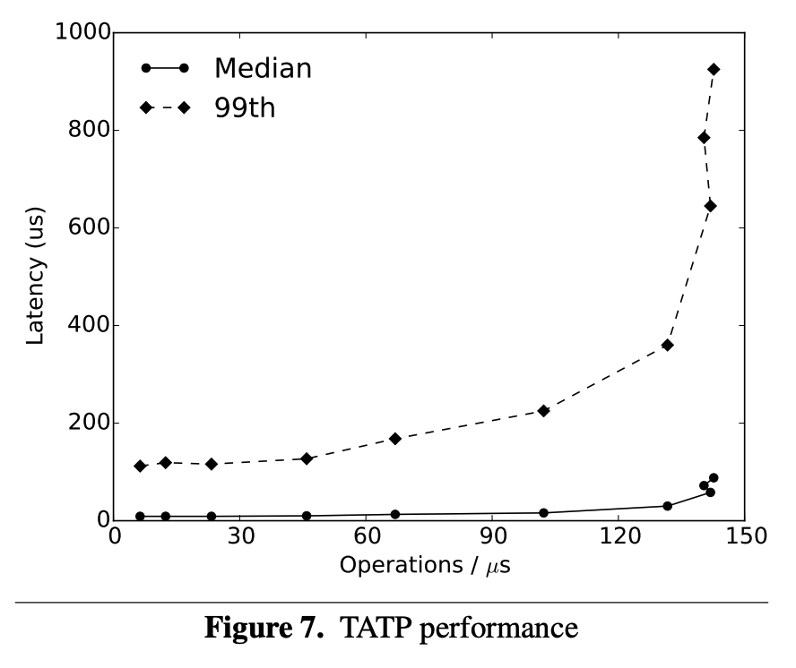
Performance

Slide 28
Performance
140 M @ 60 μs

Slide 29
Performance
130 M @ 30 μs

Slide 30
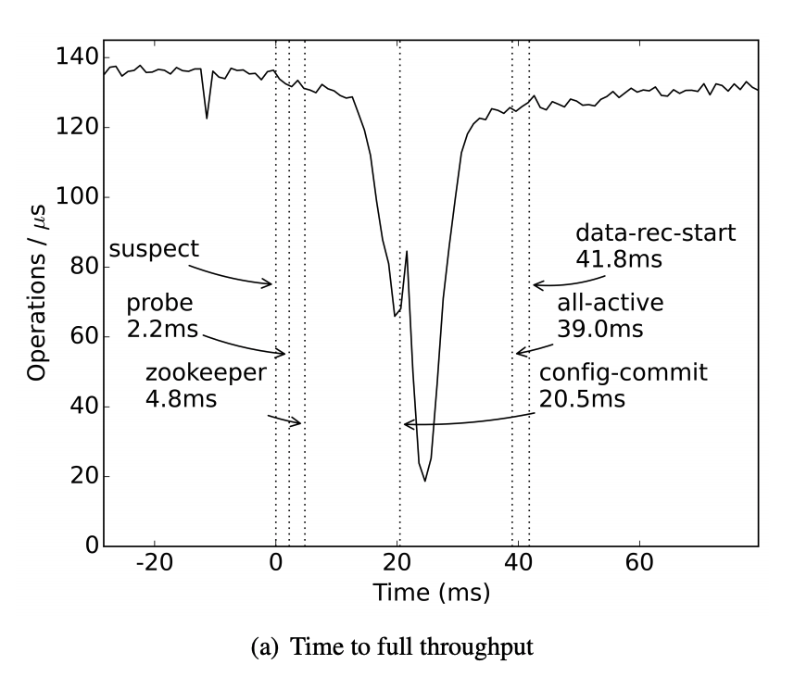
Recovery

Slide 31
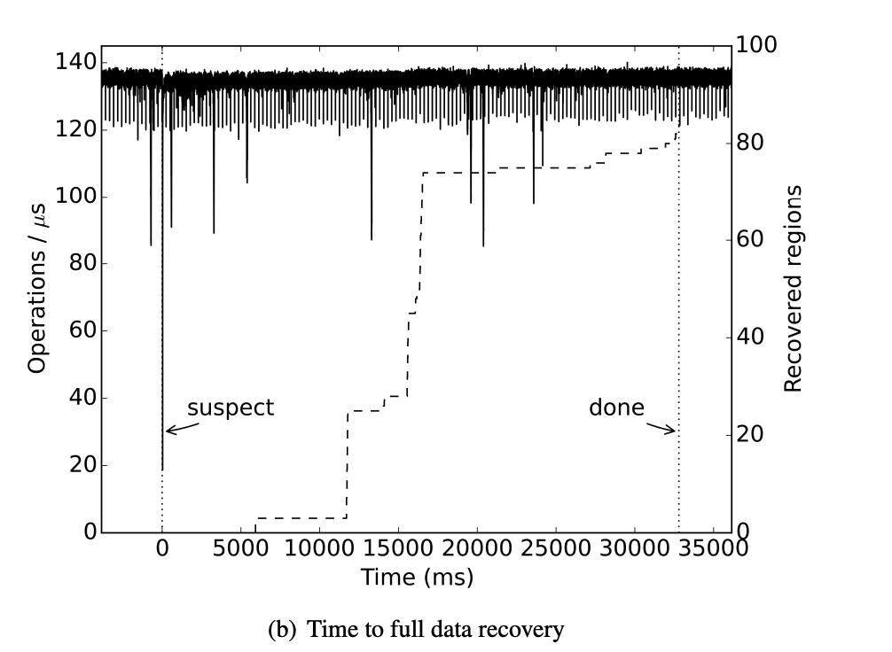
Data replication

Slide 32
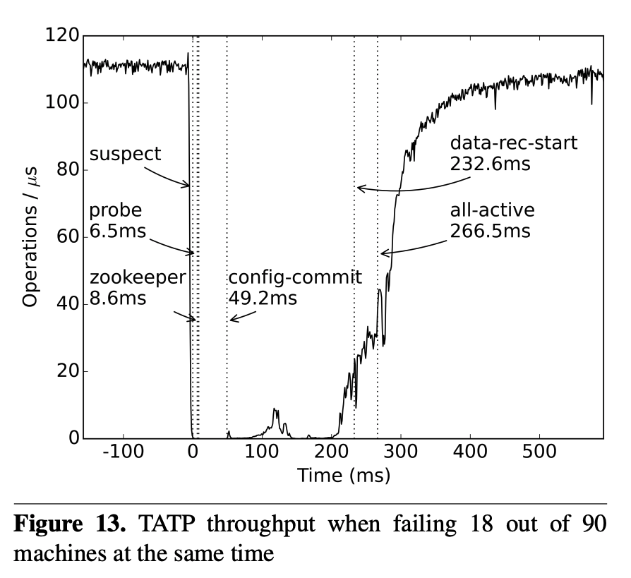
18 machines failing

Slide 33
Thanks

